Slide 1
Self-supervised Graph Representation Learning
Ahmed Emad, KTH, ESR10
Notes:
Introduce your name, ESR10
Talk about the title.

Slide 2
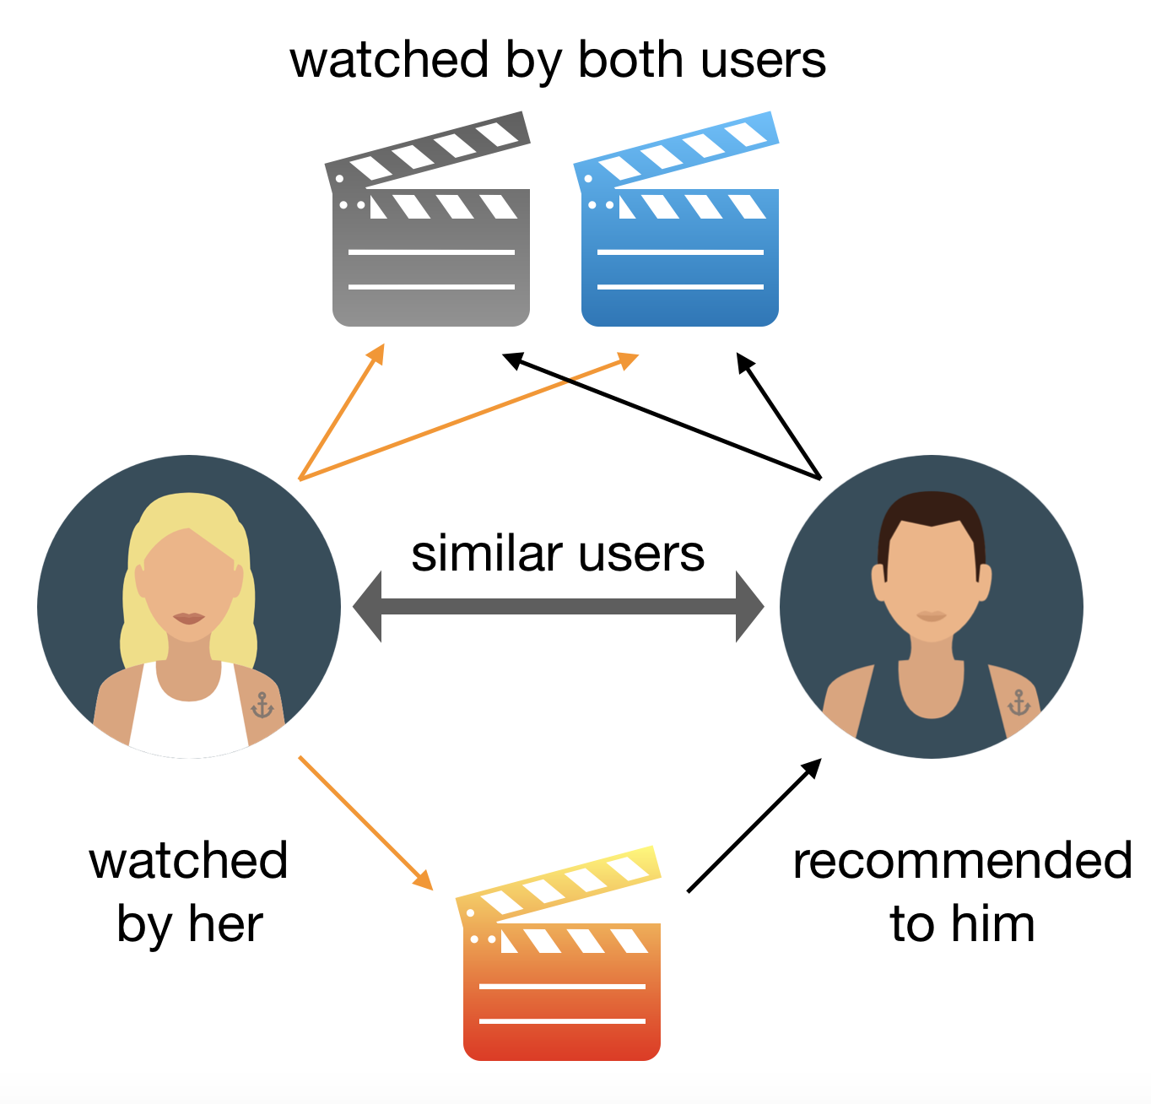
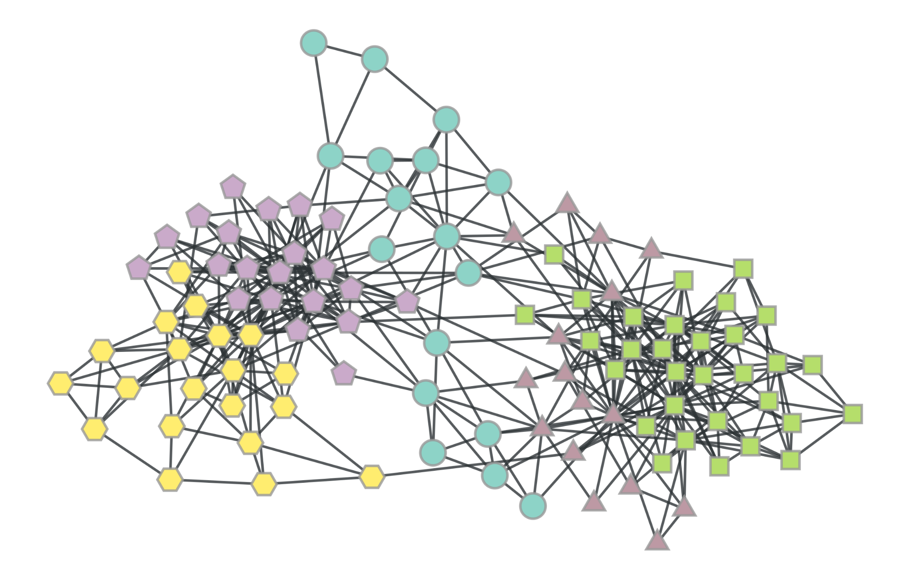
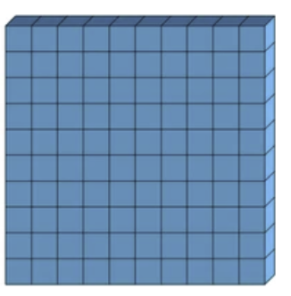
Graph Representation Learning (GRL)
The goal is to learn an encoding function that transforms each node into a low-dimensional space, while preserving attributive and structural features.
Existing research:
Mostly Focus on homogenous graphs.
Or Inadequate learning methods on HINs.
Link prediction
Node classification
Community detection..etc.
Graph Representation
Heterogeneous Information Networks (HINs):
Most real-world networks are heterogenous.
Complex structure (different edge types, node types, rich semantics and node features)
Summer School, Sep. 5-10, 2021

Slide 3
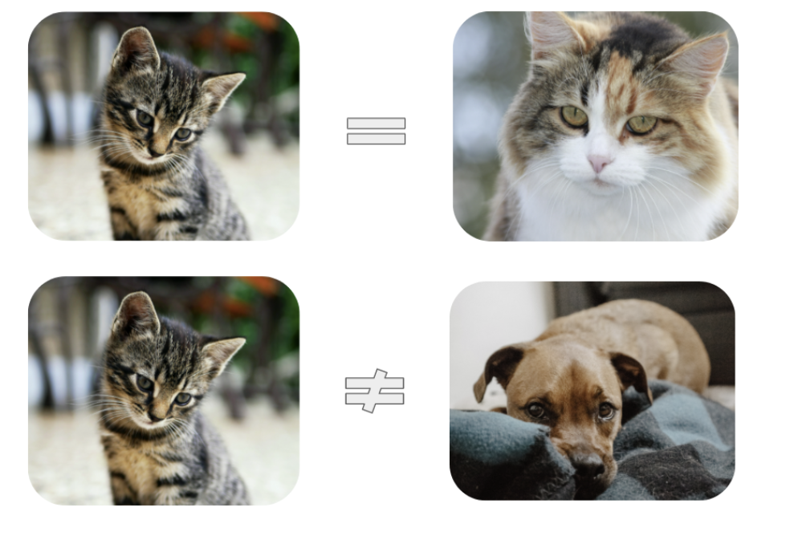
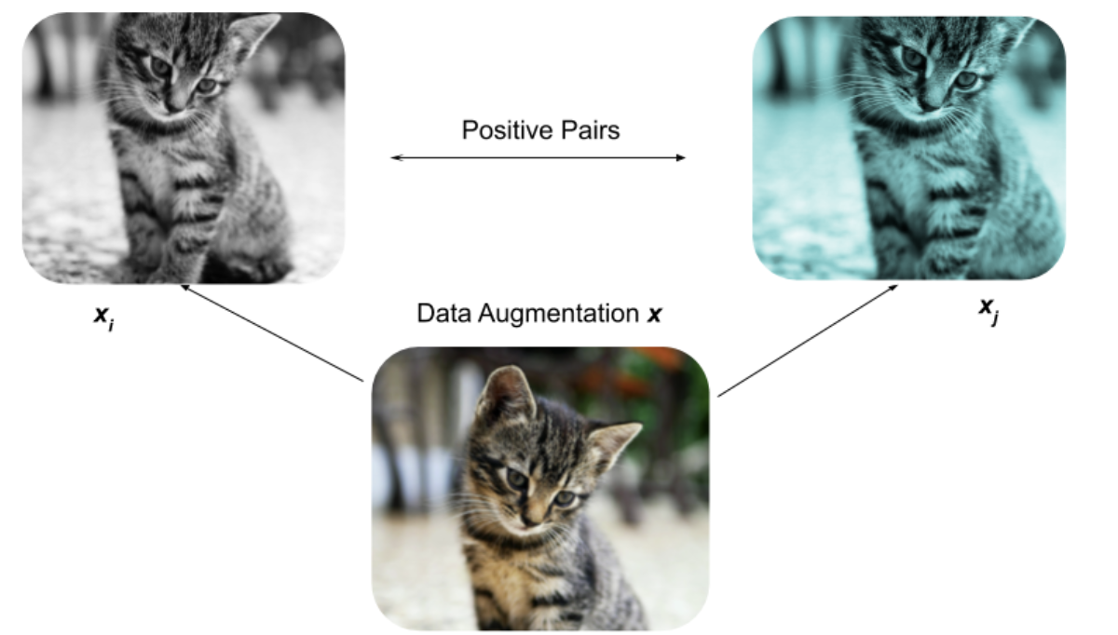
Contrastive Representation Learning (GRL)
Self-supervised Learning (SSL) is a machine learning method that obtains supervisory signals from the data itself, often leveraging the underlying structure in the data
Contrastive Learning is an SSL technique used to learn the general features of a dataset without labels by teaching the model which data points (augmented views) are similar (positive) or different (negative).
Summer School, Sep. 5-10, 2021

Slide 4
Research Roadmap: Contrastive GRL in HINs
￼
How to exploit knowledge in heterogeneous networks?
Research direction I: Graph representation learning from heterogeneous networks using Contrastive loss
Samy, A.E., Giaretta, L., Kefato, Z.T. and Girdzijauskas, Š., 2022, April. SchemaWalk: Schema Aware Random Walks for Heterogeneous Graph Embedding. In Companion Proceedings of the Web Conference 2022 (pp. 1157-1166).
Research direction II: Contrastive Representation Learning.
General contrastive learning on homogeneous and heterogeneous graphs. [in progress]
Goal: maximize the agreement between a node and similar nodes and maximize the distance with dissimilar nodes.
Summer School, Sep. 5-10, 2021

Slide 5
THANK YOU!
Summer School, Sep. 5-10, 2021

